Slide 1
FLIGHT PRICE PREDICTION PROJECT
Submitted by
Khanin Deka

Slide 2
PROBLEM STATEMENT Build a machine learning model in order to predict the price of an airline ticket.

Slide 3
The Dataset 1) The dataset contains 59707 rows and 11 columns. 2) Out of the 11 columns, the price column is of int data-type and the rest of the columns are of object data-type. 3) The data is collected from www.yatra.com for four different routes with dates ranging from 22nd September to 31st December of 2022. 4) All the flights have New Delhi as the source city and either Mumbai, Bangalore, Kolkata or Hyderabad as the destination city. 5) All the flight tickets are of economy class.

Slide 4
DATA PREPROCESSING
'Unnamed: 0' column is deleted.
914 duplicate entries are found and removed.
From the ‘Date’ column the day and month data is extracted to separate columns.
The ‘Departure Time’ column is converted to date-time format using pandas to_datetime method. Then we extract the hour and minute, and combine them to make float number which represents the original data. Then we replace the original column with the new column.
The ‘Duration’ column is converted to float data-type from text format.
‘Source’ column is deleted as all the flights have same source city.
‘Arrival Time’ column is deleted as we already have the departure time and duration data.
Data Encoding:
'Stops' and 'Ticket Status' columns are encoded using ‘replace’ function. ‘Flight_ID’ and ‘Airline’ columns are encoded using ‘LabelEncoder’ of scikit-learn. The ‘Destination’ column is encoded using the pandas ‘get_dummies’ method.

Slide 5
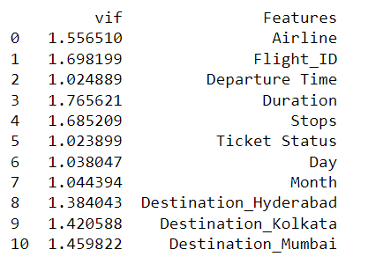
Feature Scaling:
The features are scaled using ‘StandardScaler’ of scikit-learn.
Checking VIF:
The variance inflation factor is checked for the features to know about any multicollinearity issues. No multicollinearity issues found.

Slide 6
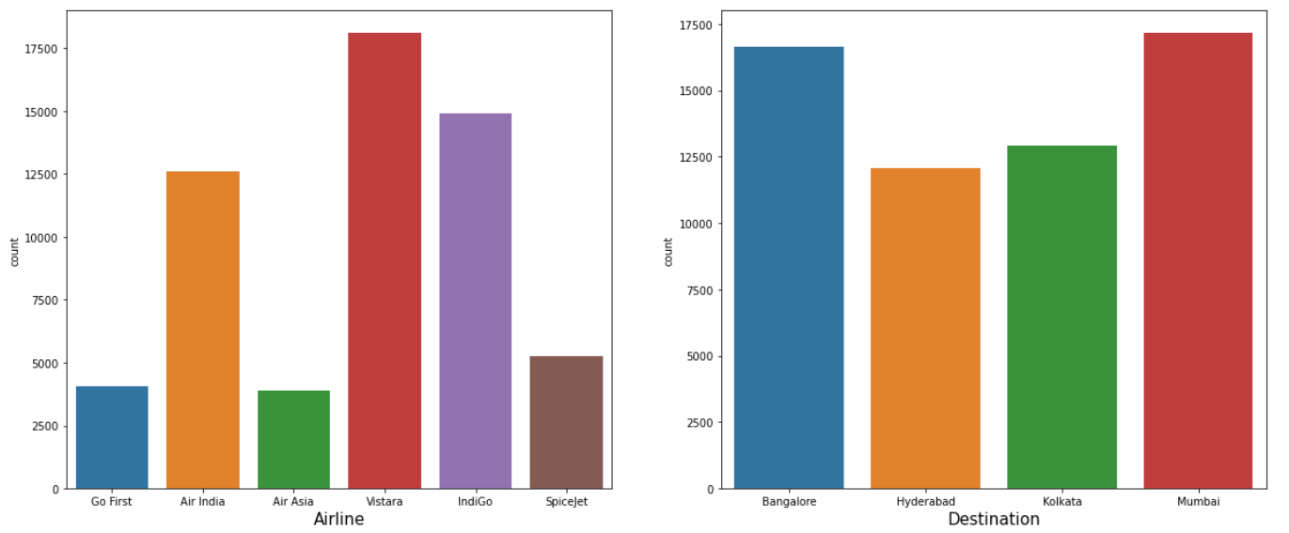
VISUALIZATION & OBSERVATIONS
Count plots of ‘Airline’ and ‘Destination’ column:

Slide 7
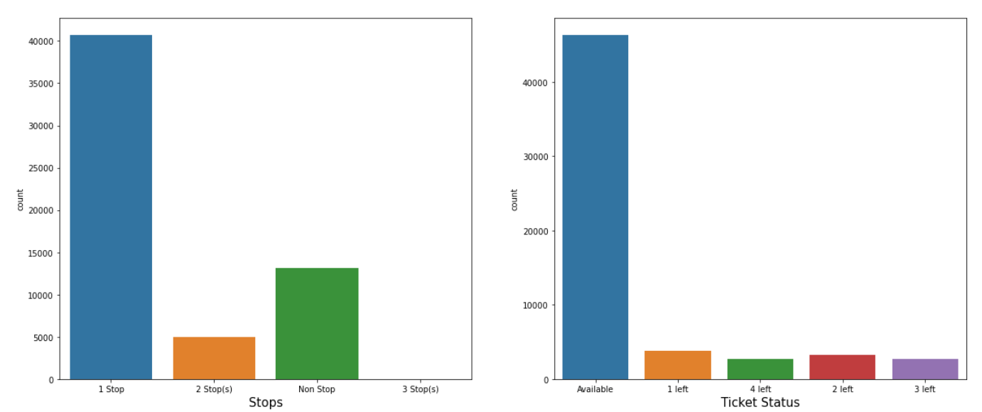
Count plots of ‘Stops’ and ‘Ticket Status’ columns: Observation: Majority of the flights have 1 stop during the journey.

Slide 8
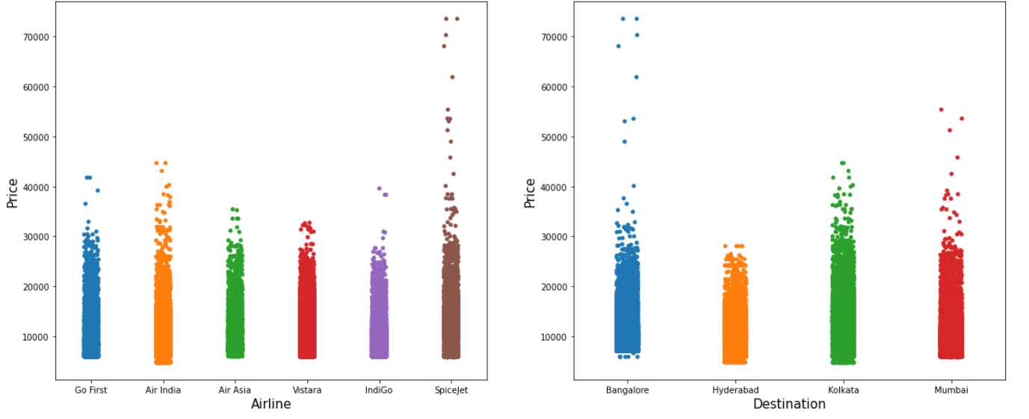
Strip plots of ‘Airline’ and ‘Destination’ columns with respect to ‘Price’: Observations: 1. The starting price of tickets for travelling to Bangalore is slightly higher than the others. This is because of higher distance from New Delhi to Bangalore.

Slide 9
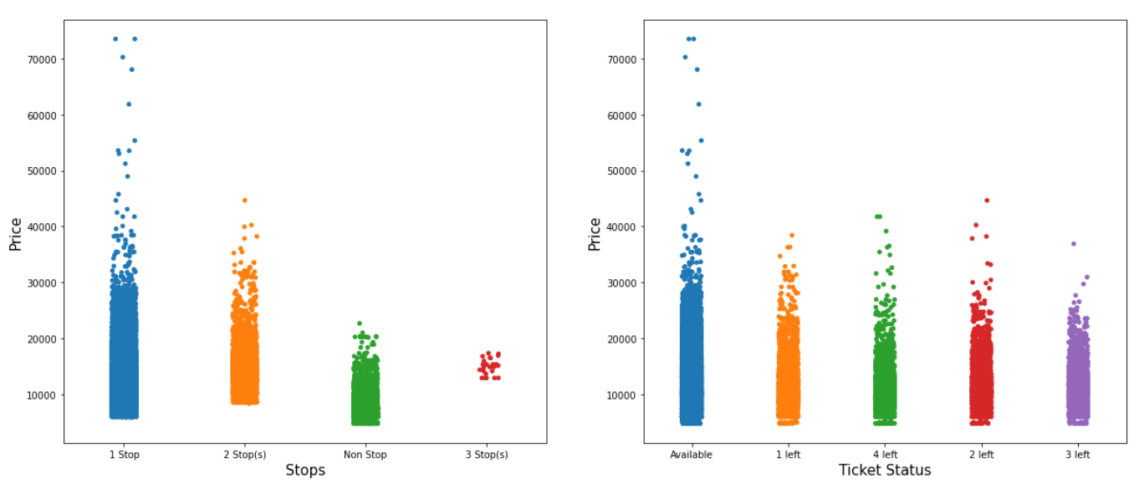
Strip plots of ‘Stops’ and ‘Ticket Status’ columns with respect to ‘Price’: Observations: 1. Flights with more stops have higher fares. 2. Ticket status doesn’t seem to affect the price much.

Slide 10
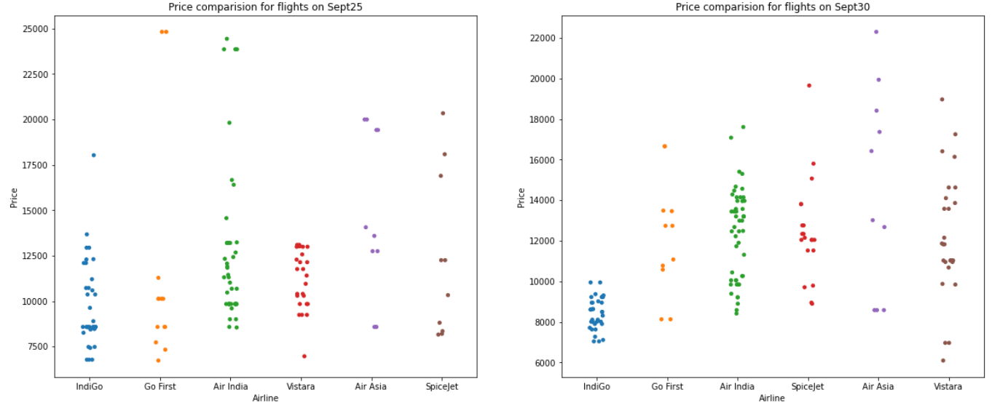
Plots to compare price among different airlines on different dates in the month of September. These plots are for New Delhi-Mumbai route having 1 stop during the journey. Observations: 1. Indigo and Go First airlines have the lowest starting fares for September 25. 2. Vistara airlines have the lowest starting fare for September 30 but the price range varies a lot. Indigo airlines have a slightly higher starting price but the range is limited near 10000 rupees.

Slide 11
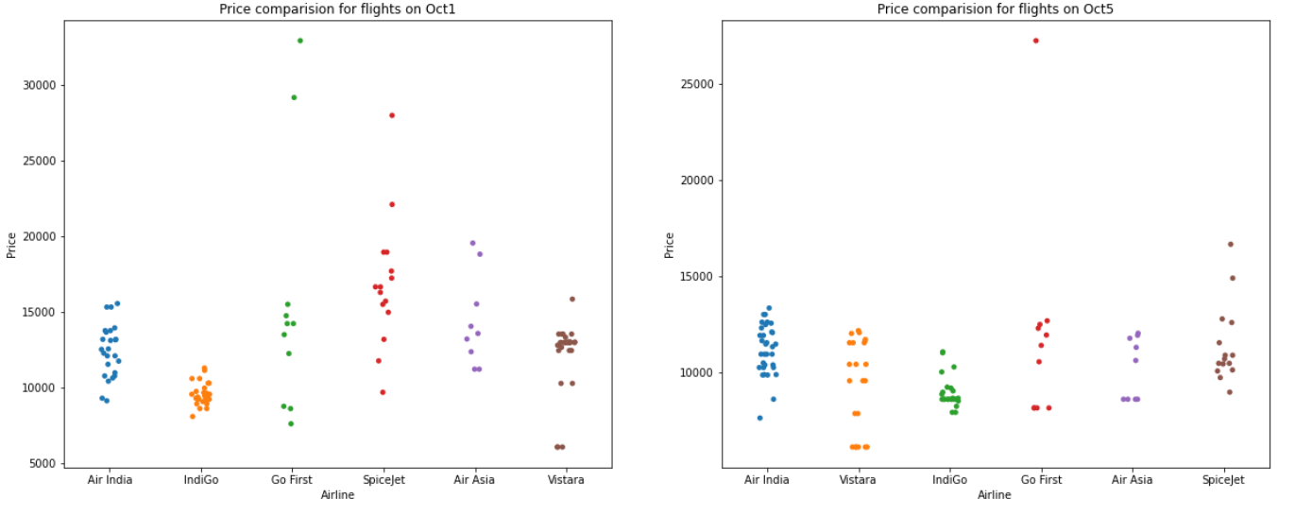
Plots to compare price among different airlines on different dates in the month of October. These plots are for New Delhi-Mumbai route having 1 stop during the journey. Observations: 1. Vistara has the lowest starting fare for flights on October 1 and 5. 2. Indigo airlines have lesser variation of price as compared to others. 3. AirAsia and Spicejet have a higher starting price compared to others.

Slide 12
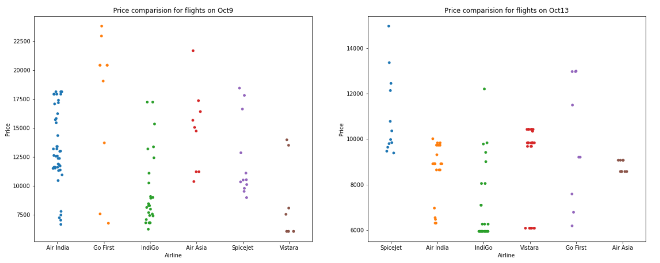
Plots to compare price among different airlines on different dates in the month of October. These plots are for New Delhi-Mumbai route having 1 stop during the journey. Observations: 1. On October 9 and 13, Vistara and Indigo have almost same starting fares. 2. AirAsia and Spicejet have a higher starting price compared to others.

Slide 13
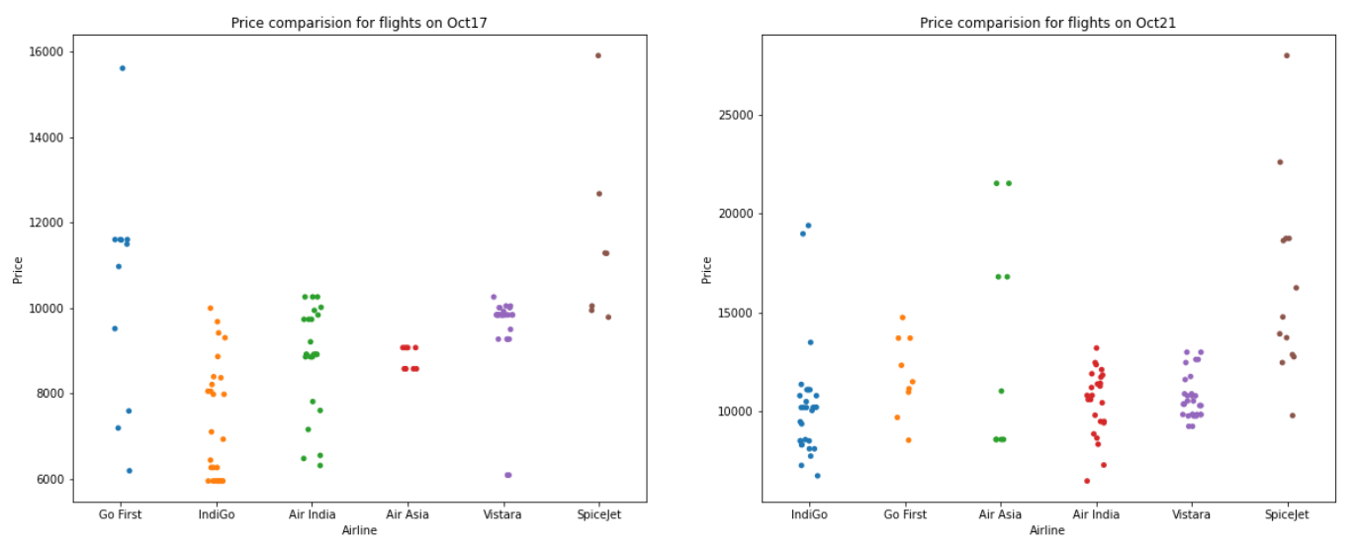
Plots to compare price among different airlines on different dates in the month of October. These plots are for New Delhi-Mumbai route having 1 stop during the journey. Observations: 1. Indigo airlines have the lowest starting fare on October 17. On October 21 Air India have the lowest starting fare, Indigo have slightly higher price. 2. AirAsia and Spicejet have a higher starting price compared to others.

Slide 14
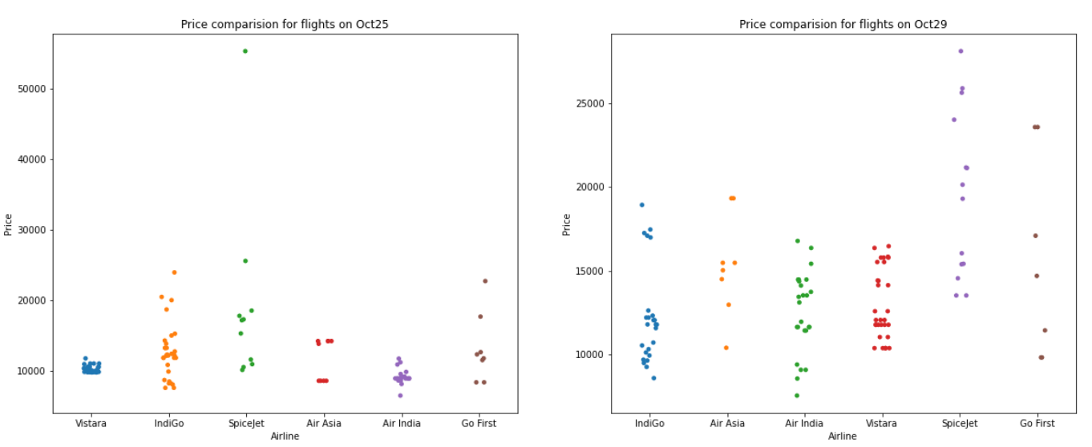
Plots to compare price among different airlines on different dates in the month of October. These plots are for New Delhi-Mumbai route having 1 stop during the journey. Observations: 1. On October 25 and 29 Air India have the lowest starting fare, Indigo have slightly higher price. 2. Spicejet have a higher starting price compared to others.

Slide 15
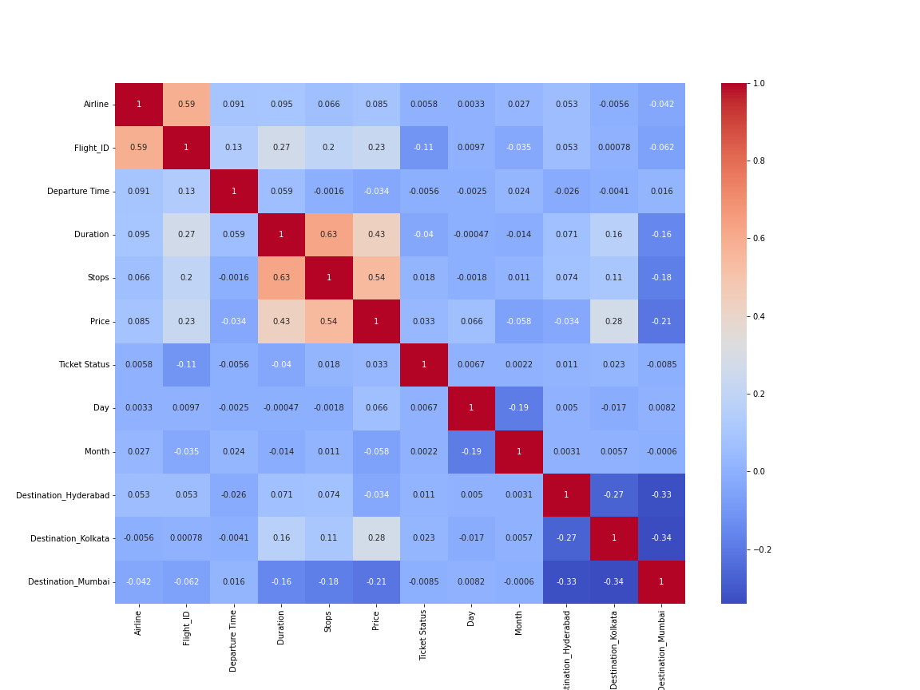
Correlation Heatmap Observations: 1. Number of stops and flight duration have the highest correlation with the price. 2. No multicollinearity issues can be seen.

Slide 16
Performance Evaluation
We will use the coefficient of determination (R²) to evaluate the models’ performance. The R² score for a model is a useful statistic in regression analysis, as it often describes how ‘good’ that model is at making predictions.
The performance is evaluated for five different algorithms. They are: a) Linear Regression
b) AdaBoost Regression
c) Random Forests Regression
d) XGBoost Regression
e) KNN Regression.
First the scores are observed for 5 different train-test splits and then the score is cross-validated for each of the models.

Slide 17
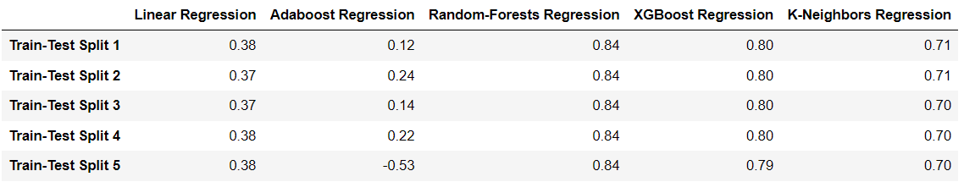
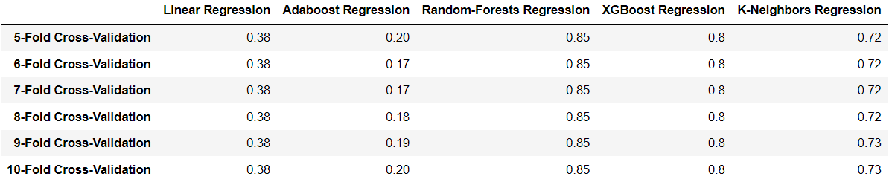
Let’s see the R² scores of the 5 different algorithms on 5 different train-test splits: Let’s see the cross-validation results: From the above results it can be seen that Random-Forests is giving the best results.

Slide 18
CONCLUSION Key Findings: 1. Number of stops and flight duration are the features which affect the price most. 2. Indigo Airlines have relatively less price variations as compared to others. 3. In most of the cases it is beneficial to purchase a flight ticket at least a month before travel. The variation of price is lesser in this case. 4. Random Forests Regression Algorithm is giving the best results for prediction of price. Limitations of this work: 1. The hyper-parameters of our final model can be further tuned. 2. In data collection phase we collected data of 10 features and the price. Some more feature data can also be collected. For example, name of the cities where the flight have stops, in-flight miscellaneous services like meals, etc. 3. In this project we worked on only 5 algorithms. There are numerous other regression algorithms with which we can try to make a better model.

